Slide 1
BBM-382 – SOFTWARE ENGINEERING
SPRING 2018
Lecture 8
Dr. Ayça TARHAN

Slide 2
Reference:
Textbook Ch8-Software Testing Lecture Notes by Vahid Garousi

Slide 3

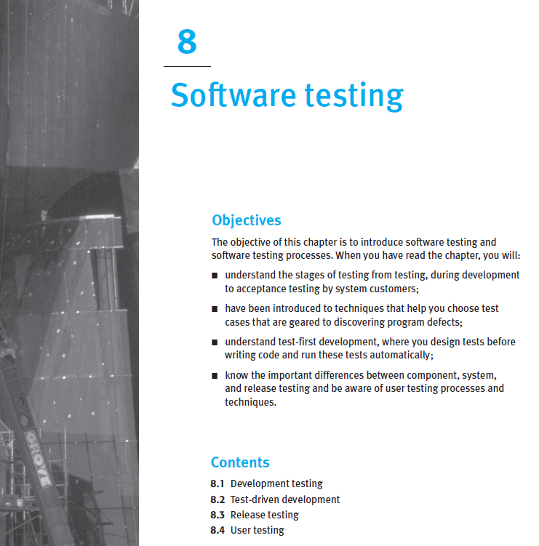
From the book
Read it online!

Slide 4
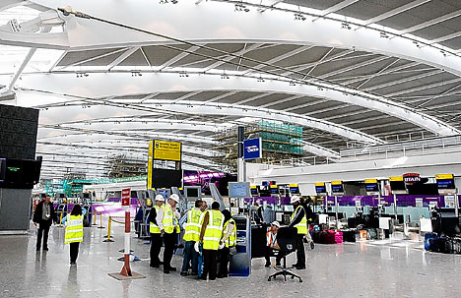
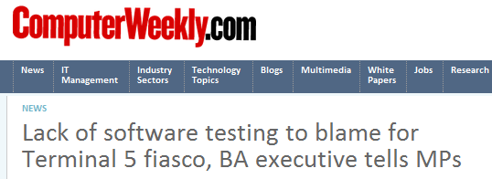
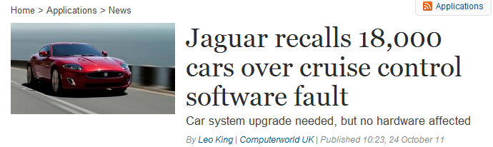
Need for SW testing-Examples of SW Failures

Slide 5
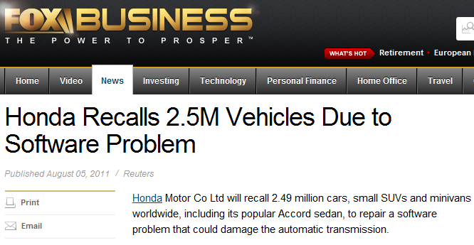
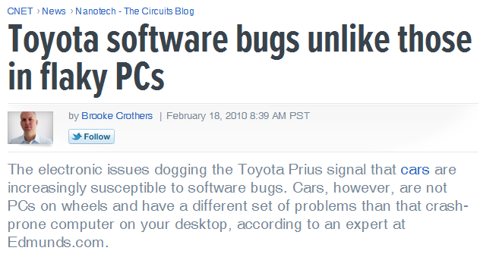
Examples of Software Failures

Slide 6
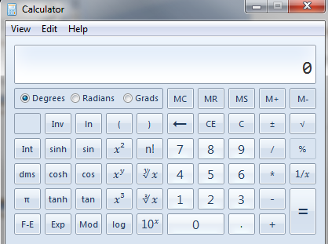
Brain storming: How will you test the Win Calculator?
Test plan
How many inputs (test cases)?
So MANY possibilities
How do we know if we have tested the system “enough”?
How do we know if the outputs are correct!?
If the system changes, shall we test everything AGAIN?
Tedious!

Slide 7
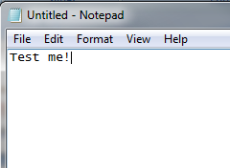
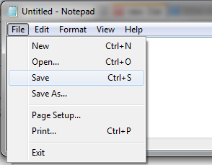
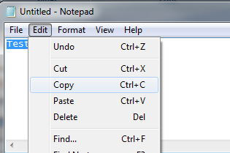
Brain storming: How will you test the Notepad?
Test-case Design: Exploratory
Test-case Design: Criteria-based
Test Automation
Test Evaluation

Slide 8
Introduction to Software Testing- Outline
Definitions
Why is SW testing important?
Examples of Software Failures
Dealing with SW Faults
Testing Process Overview
What is a Test Case and Test Suite (Test Set)?
Types of Test Activities
Types of Testing
Test Levels/ Test Organization
Testing can be Manual or Automatic
What is a good test case?
Exhaustive (Complete) Testing
Test Adequacy and Coverage: When can we say testing is enough?
Testing throughout the Software Development Life Cycle
Testing Maturity Levels

Slide 9
Definitions
SW Project Management: The discipline of managing projects to achieve quality within time constraints and budget.
SW Quality (Engineering): The discipline of specifying, assuring, monitoring, and controlling the quality of software products.
SW Verification: Did we build the product right?
Ensures that the product satisfies or matches the original design (low-level checking).
This is usually done through white-box testing.
SW Validation: Did we built the right product?
Checks that the product design satisfies or fits the intended usage (high-level checking).
This is usually done through black-box testing.

Slide 10

Definitions
SW Testing: Techniques to execute programs with the intent of finding as many defects as possible and/or gaining sufficient confidence in the software system under test.
“Program testing can show the presence of bugs, but never their absence” (Edsger Dijkstra, 1930-2002)
SW Inspections: Techniques aimed at systematically verifying software artifacts (design documents, code, tests, etc) with the intent of finding as many defects as possible, as early as possible.

Slide 11
What SW testing is and is NOT
Testing is to execute a program with the intent of finding as many defects as possible and/or gaining sufficient confidence in the software system under test
Testing is not cut-and-fit improvement of a user interface or requirements elicitation by prototyping.
Testing is not the verification of an analysis or design model by syntax checkers or simulation.
Testing is not the scrutiny of documentation or code by humans in inspections, reviews, or walkthroughs.
Testing is not static analysis of code using a language translator or code checker.
Testing is not the use of dynamic analyzers to identify memory leaks or similar problems.
Testing is not debugging, although successful testing should lead to debugging.

Slide 12
Goals and Limitations of Testing
Dijkstra, 1972:
“Program testing can be used to show the presence of bugs, but never to show their absence”
Thus:
No absolute certainty can be gained from testing
Testing should be integrated with other SW quality activities, e.g., code reviews and inspections
Main goal of testing: demonstrate the software can be depended upon, i.e., sufficient dependability
We can only gain sufficient confidence in the System Under Test (SUT), but not full confidence!
Notes:
The concept of dependability is complex and we will revisit it soon

Slide 13
Basic Testing Definitions
Error: the very root cause. Errors are committed by people
Fault: A fault is the result of a human error in the software documentation, code, etc.
Failure: A failure occurs when a fault executes
(Many people use the above three terms inter-changeably. We should not do so!)
Incident: Consequences of failures – Failure occurrence may or may not be apparent to the user
Defect: any of the above, usually a fault, a.k.a. bug
E.g., people say: “my code has a bug!”
The fundamental chain of SW dependability threats:
Notes:
13
From IEEE standard definitions
The point here is to clarify up-front our terminology

Slide 14
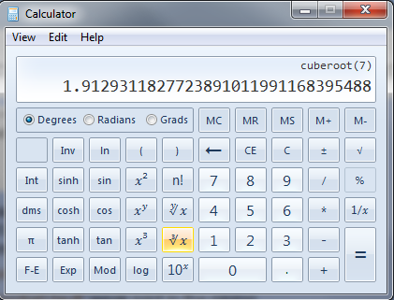
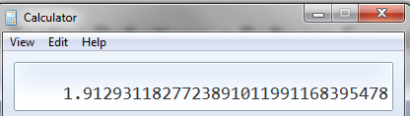
Basic Testing Definitions: a Software Example
Cube root of 7 in Calculator App:
The is the correct expected value:
A human SW tester runs the app
manually and gets:
She does not notice the fault in this case.
Let’s discuss the possible errors, faults and failures in this case.

Slide 15
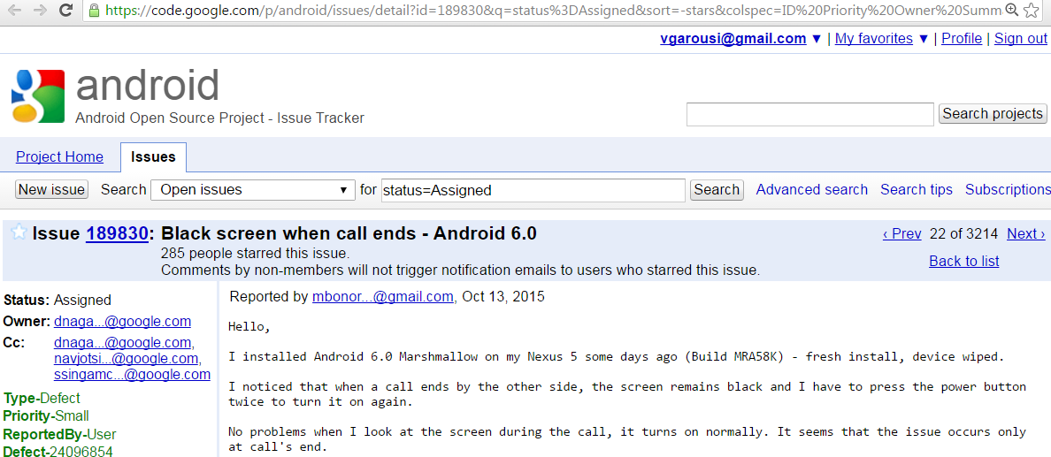
Exercise
The following is an actual defect report from the Android open-source smart-phone platform.
In this example, identify the three involved fundamental threats of software dependability (errors, fault, and failure).
Conceptualize your ideas into a causation graph similar to the one provided below.
Was in exam a few years ago!

Slide 16
Introduction to Software Testing- Outline
Definitions
Why is SW testing important?
Examples of Software Failures
Dealing with SW Faults
Testing Process Overview
What is a Test Case and Test Suite (Test Set)?
Types of Test Activities
Types of Testing
Test Levels/ Test Organization
Testing can be Manual or Automatic
What is a good test case?
Exhaustive (Complete) Testing
Test Adequacy and Coverage: When can we say testing is enough?
Testing throughout the Software Development Life Cycle
Testing Maturity Levels

Slide 17
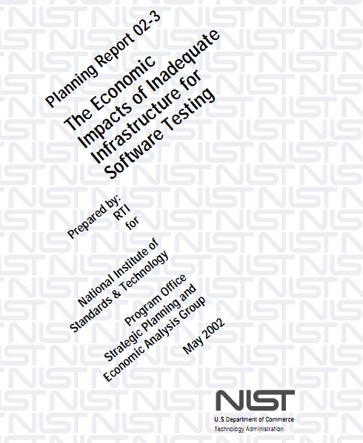
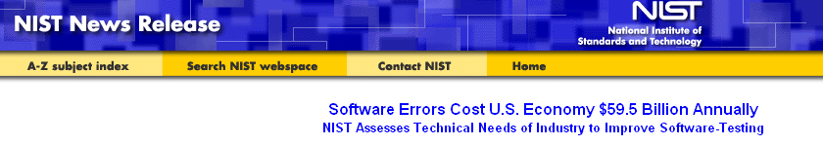
Why is SW testing important?
A study by (the American) NIST in 2002: The annual national cost of inadequate testing is as much as $59 Billion US!
The report is titled: “The Economic Impacts of Inadequate Infrastructure for Software Testing”
http://www.nist.gov/public_affairs/releases/n02-10.htm

Slide 18
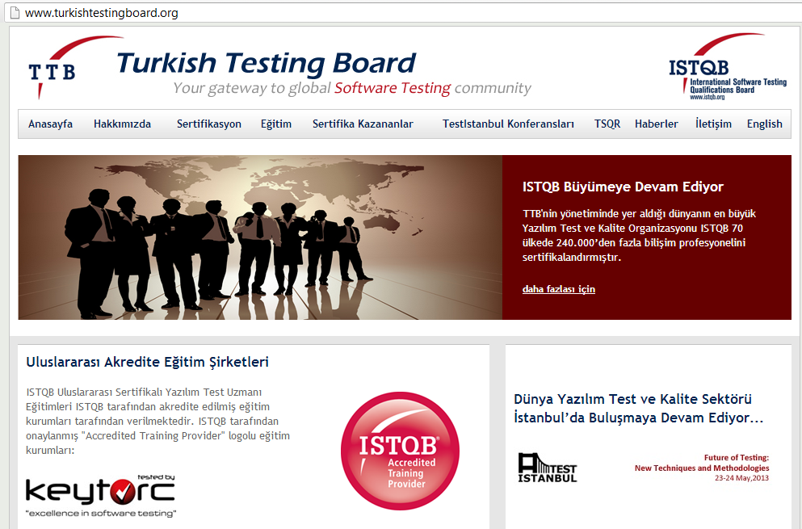

Slide 19
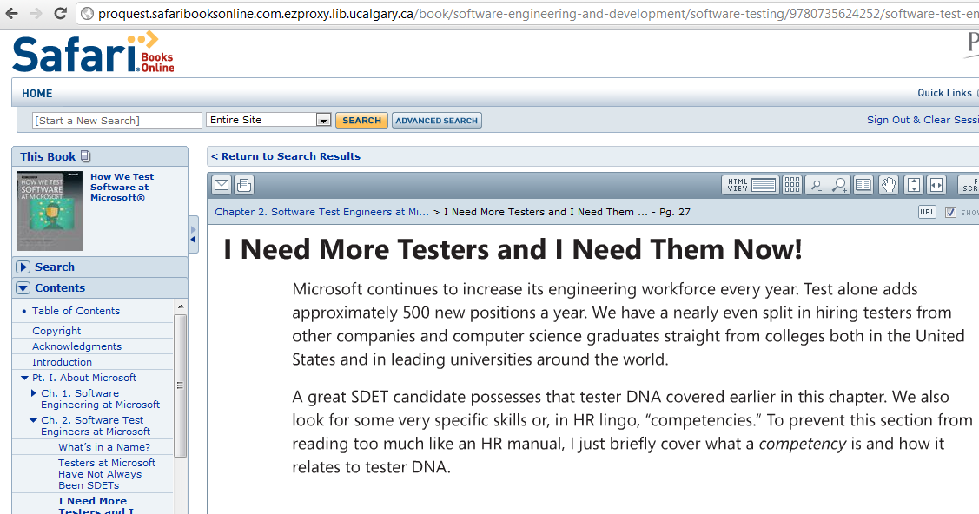
Software Test Engineers at Microsoft

Slide 20
Introduction to Software Testing- Outline
Definitions
Why is SW testing important?
Examples of Software Failures
Dealing with SW Faults
Testing Process Overview
What is a Test Case and Test Suite (Test Set)?
Types of Test Activities
Types of Testing
Test Levels/ Test Organization
Testing can be Manual or Automatic
What is a good test case?
Exhaustive (Complete) Testing
Test Adequacy and Coverage: When can we say testing is enough?
Testing throughout the Software Development Life Cycle
Testing Maturity Levels

Slide 21
Dealing with SW Faults / Software Quality Engineering (SQE)
Fault Handling
Fault Avoidance
Fault Detection
Fault Tolerance
Design
Methodology
Inspections
Atomic
Transactions
Modular
Redundancy
Verification &
Validation
Configuration
Management
Our focus in this course
Testing
Comes after
Debugging
Unit
Testing
Integration
Testing
System
Testing
Non-functional
Testing
Functional
Debugging
Non-functional
Debugging
Notes:
21
To replace what we are going to address in context …

Slide 22
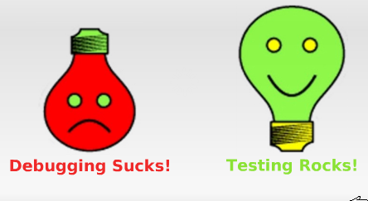
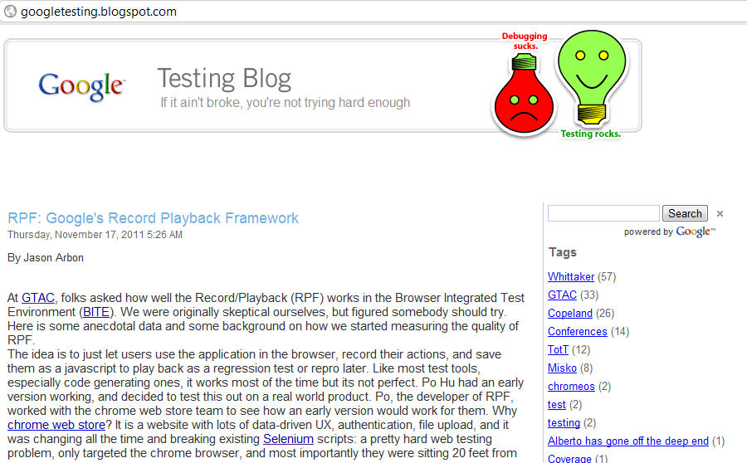
Motto from Google!

Slide 23


Testing Process Overview
SW Representation
(e.g., models, requirements, code)
Derive Test cases
Estimate Expected Results
(test oracle)
SW Code
Execute Test cases
Get Test Results
Compare
[Test Result==Exp. Res.]
[Test Result!=Exp. Res.]
Notes:
Producing test cases and an oracle is difficult and time consuming
The concept of Oracle is a key concept in testing
Testing is also very dependent on representation form and content, e.g., specs formalism

Slide 24
Introduction to Software Testing- Outline
Definitions
Why is SW testing important?
Examples of Software Failures
Dealing with SW Faults
Testing Process Overview
What is a Test Case and Test Suite (Test Set)?
Types of Test Activities
Types of Testing
Test Levels/ Test Organization
Testing can be Manual or Automatic
What is a good test case?
Exhaustive (Complete) Testing
Test Adequacy and Coverage: When can we say testing is enough?
Testing throughout the Software Development Life Cycle
Testing Maturity Levels

Slide 25
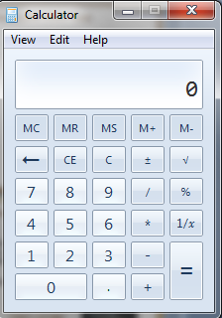
What is a Test Case and Test Suite (Test Set)?
A test case is set of inputs and the expected outputs for a unit/module/system under test
A test suite (test set) is set of test cases (at least one)
Without the expected outputs, a test case is NOT complete.
For Example, for Calculator:
TC# | Unit under test | Input 1 | Input 2 | Expected output
1 | + | 5 | 6 | 11
2 | + | 16 | 0 | 16
3 | / | 5 | 2 | 2.5
4 | / | 4 | 0 | Cannot divide
 | …
 | So many more test cases!
Notes:
PRE: -32768 <= x <= +32767, POST: y=int(x)
It would seem likely that the programmer of the subprogram for converting a floating point number to a signed 16 bit number realized that the value of the floating point number to be converted must lie within a restricted range, namely the range of values which (after truncating or rounding to an integer) can be represented as a signed 16 bit number. Such restrictions on input values (preconditions for subprograms) were, however, neither systematically
derived, documented nor followed back to determine corresponding restrictions on other values computed earlier [1].
The SRI was no longer needed, for Ariane 5, when it failed …
As a result, because there was no exception handling, or back-up procedure, when the flight system realized the data from the SRI were flawed, the whole flight system shut off.

Slide 26
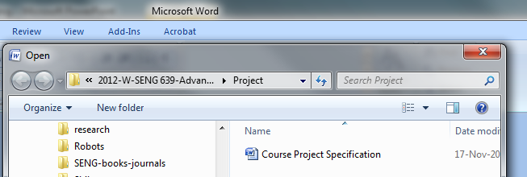
Test Case and Test Suite (Test Set)
The above definitions hold for test cases in any level: unit, integration or system testing
Example, for Microsoft Word:
TC# | Feature under test | Inputs | Expected output
1 | Open | Valid DOCX file | File opened properly
2 | Open | Invalid DOCX file | Error message
3 | Open | RTF file | File opened properly
 | …
 | So many more test cases!
Notes:
PRE: -32768 <= x <= +32767, POST: y=int(x)
It would seem likely that the programmer of the subprogram for converting a floating point number to a signed 16 bit number realized that the value of the floating point number to be converted must lie within a restricted range, namely the range of values which (after truncating or rounding to an integer) can be represented as a signed 16 bit number. Such restrictions on input values (preconditions for subprograms) were, however, neither systematically
derived, documented nor followed back to determine corresponding restrictions on other values computed earlier [1].
The SRI was no longer needed, for Ariane 5, when it failed …
As a result, because there was no exception handling, or back-up procedure, when the flight system realized the data from the SRI were flawed, the whole flight system shut off.

Slide 27
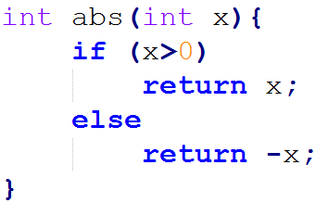
Test Case and Test Suite (Test Set)
The definitions hold for test cases in any level, unit, integration or system testing
Example, for the abs function:
The art and science of deriving efficient but effective number of test cases is called “test-case design”.
“Less is more!” - Less test cases, but maximizing the chance of covering faults.
TC# | Unit (method) under test | Inputs | Expected output
1 | abs | A +ve, 3 | 3
2 | abs | A –ve, -5 | 5
 | Are two test cases enough? What about 0?
Notes:
PRE: -32768 <= x <= +32767, POST: y=int(x)
It would seem likely that the programmer of the subprogram for converting a floating point number to a signed 16 bit number realized that the value of the floating point number to be converted must lie within a restricted range, namely the range of values which (after truncating or rounding to an integer) can be represented as a signed 16 bit number. Such restrictions on input values (preconditions for subprograms) were, however, neither systematically
derived, documented nor followed back to determine corresponding restrictions on other values computed earlier [1].
The SRI was no longer needed, for Ariane 5, when it failed …
As a result, because there was no exception handling, or back-up procedure, when the flight system realized the data from the SRI were flawed, the whole flight system shut off.

Slide 28
Introduction to Software Testing- Outline
Definitions
Why is SW testing important?
Examples of Software Failures
Dealing with SW Faults
Testing Process Overview
What is a Test Case and Test Suite (Test Set)?
Types of Test Activities
Types of Testing
Test Levels/ Test Organization
Testing can be Manual or Automatic
What is a good test case?
Exhaustive (Complete) Testing
Test Adequacy and Coverage: When can we say testing is enough?
Testing throughout the Software Development Life Cycle
Testing Maturity Levels

Slide 29

Types of Test Activities
Test-case Design: Exploratory (Human-based)
Design test values based on domain knowledge of the program and human knowledge of testing, exploratory testing
Test-case Design: Criteria-based
Design test values to satisfy coverage criteria, covering all lines of code
Test Automation
Embed test values into executable scripts
Test Execution
Run tests on the software and record the results
Test Evaluation
Evaluate results of testing, report to developers

Slide 30
Introduction to Software Testing- Outline
Definitions
Why is SW testing important?
Examples of Software Failures
Dealing with SW Faults
Testing Process Overview
What is a Test Case and Test Suite (Test Set)?
Types of Test Activities
Types of Testing
Test Levels/ Test Organization
Testing can be Manual or Automatic
What is a good test case?
Exhaustive (Complete) Testing
Test Adequacy and Coverage: When can we say testing is enough?
Testing throughout the Software Development Life Cycle
Testing Maturity Levels

Slide 31
Types of Testing
Functional Testing: testing functional requirements
Functional testing is checking correct functionality of a system
Non-functional Testing: testing non-functional requirements
Performance testing
Load testing
Endurance testing
Localization/Internationalization testing
Recovery testing
Security testing
Stress testing
Installation testing
Compatibility testing
Usability testing
Scalability testing
Reliability testing
…ilities!

Slide 32
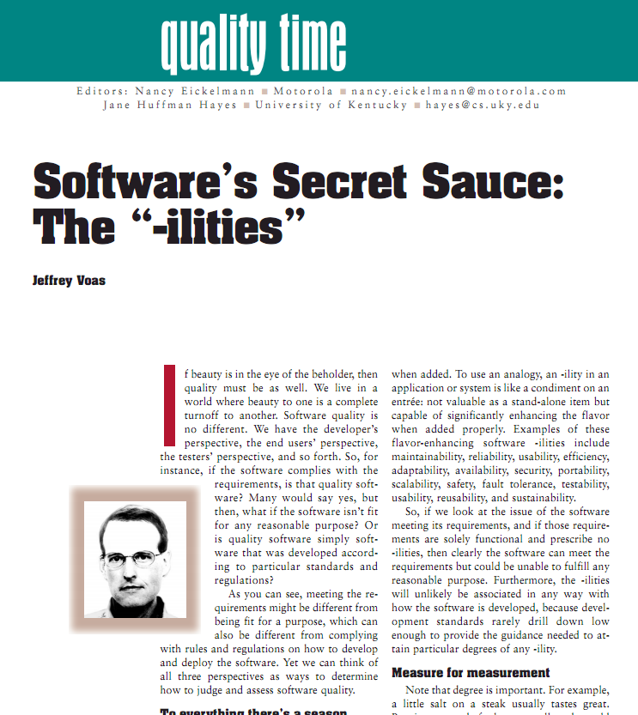
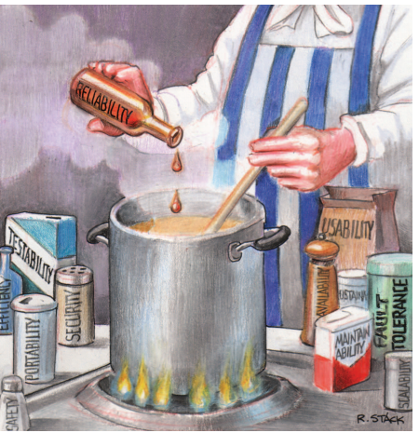

Slide 33
Test Levels / Test Organization
Since we can have defects in different level and stages of the SW process, we need testing at different levels and stages
Unit testing (also called module or component testing)
Integration testing
System testing
Non-functional (e.g., performance) testing
Acceptance testing
Installation testing
…
One typical test process comes next…
Notes:
Typically, different names are used in different organizations
System test = function + performance test
Test cannot focus on all problems at once – divide and conquer to be more efficient

Slide 34
Test Organization (just one typical test process)
Unit
testing
Design
descriptions
System
functional
specifications
System
Non-functional
specifications
User
environment
Customer
requirements
Tested unit
Unit code
Unit
testing
.
.
.
Integration
testing
System
testing
Non-
functional
testing
Acceptance
testing
Installation
testing
Unit code
Integrated
modules
Functioning
system
Non-functionally
tested
software
Accepted
system
Unit
testing
Tested unit
SYSTEM
IN USE!
Unit code
Pfleeger, 1998
Notes:
Pfleeger, Software Engineering: Theory and Practice, 1998
Typical test activities, inputs, and outputs in the life cycle
Test planning and preparation should happen early in the life cycle
Common terminology: system test = function + performance test

Slide 35
Introduction to Software Testing- Outline
Definitions
Why is SW testing important?
Examples of Software Failures
Dealing with SW Faults
Testing Process Overview
What is a Test Case and Test Suite (Test Set)?
Types of Test Activities
Types of Testing
Test Levels/ Test Organization
Testing can be Manual or Automated
What is a good test case?
Exhaustive (Complete) Testing
Test Adequacy and Coverage: When can we say testing is enough?
Testing throughout the Software Development Life Cycle
Testing Maturity Levels

Slide 36

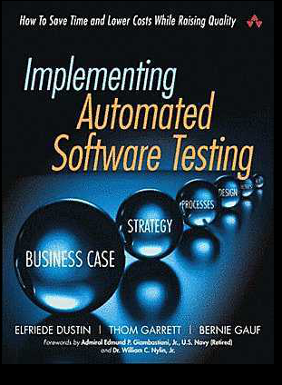
Testing can be Manual or Automated
Manual Testing
Clever test-case design
Interaction with system inspiration for new tests
Human oracle
Single test case execution
Limited data
Automated Testing
Specs, models, & code used to derive test cases
Automated oracle needed
Test execution easily repeatable
Massive input data possible
Clearly,
we need both
and
both have
advantages/ disadvantages

Slide 37
Manual Testing: Exploratory Software Testing
Human tester
using brain, and fingers
to create scenarios that
will cause software either to fail or to fulfill its mission
Take advantage of human cleverness
No scripts: Exploratory Testing
Or manual scripted testing
Record test findings as you go
Notes:
PRE: -32768 <= x <= +32767, POST: y=int(x)
It would seem likely that the programmer of the subprogram for converting a floating point number to a signed 16 bit number realized that the value of the floating point number to be converted must lie within a restricted range, namely the range of values which (after truncating or rounding to an integer) can be represented as a signed 16 bit number. Such restrictions on input values (preconditions for subprograms) were, however, neither systematically
derived, documented nor followed back to determine corresponding restrictions on other values computed earlier [1].
The SRI was no longer needed, for Ariane 5, when it failed …
As a result, because there was no exception handling, or back-up procedure, when the flight system realized the data from the SRI were flawed, the whole flight system shut off.

Slide 38

The Problem with Manual Testing
Not very repeatable
Either cannot remember exactly how it was last tested (what input value did I use a month ago to fail the software?)
Or, too expensive to document detailed procedures. Perhaps you have seen “thick” manual test scripts still some companies use.
Very effort intensive
How long will it take to re-run all the tests?
How often will you actually do it?

Slide 39
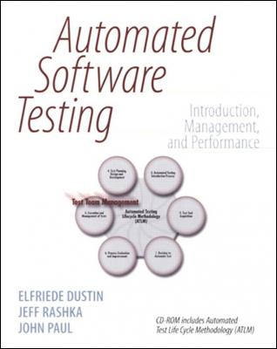
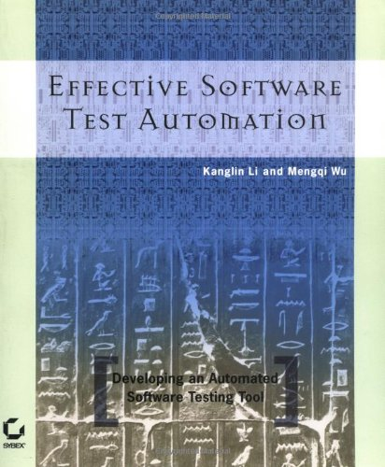
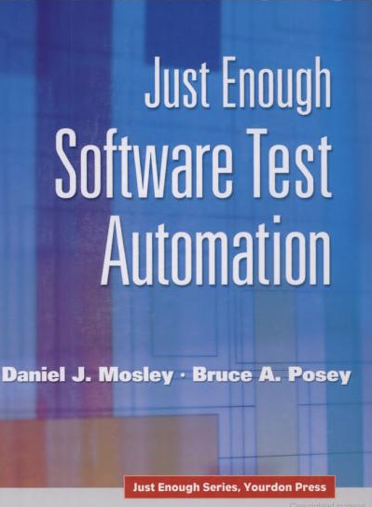
Automated testing
Using a test software (tool) to test another software
Developing test code (script) to test other piece of code (application code)
How much do you know about it?

Slide 40
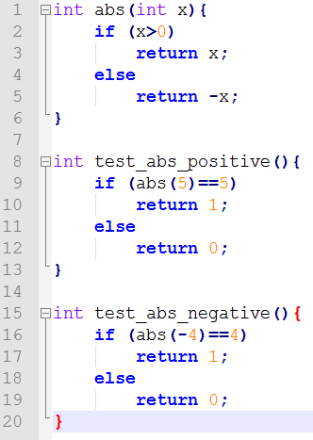
Why Automate Tests?
It gives us rapid feedback (pass/fail)!
Repeatable
Much faster than human testers, but needs up-front investment
How do we know where defects are?
We remember where we put them!
Defect (fault) localizations

Slide 41



Increasing size and complexity for automated test systems
“We designed a test system that probably is as complicated as the system itself.”
Jeff Feldstein, Manager, Software Development
Cisco Systems, San Jose, California
Google Tech Talks, November 9, 2005
(a very good talk)

Slide 42
Introduction to Software Testing- Outline
Definitions
Why is SW testing important?
Examples of Software Failures
Dealing with SW Faults
Testing Process Overview
What is a Test Case and Test Suite (Test Set)?
Types of Test Activities
Types of Testing
Test Levels/ Test Organization
Testing can be Manual or Automated
What is a good test case?
Exhaustive (Complete) Testing
Test Adequacy and Coverage: When can we say testing is enough?
Testing throughout the Software Development Life Cycle
Testing Maturity Levels

Slide 43
Exhaustive (Complete) Testing
Exhaustive testing, i.e., testing a software system using all the possible inputs, is most of the time impossible.
Examples:
A program that computes the factorial function (n!=n.(n-1).(n-2)…1)
Exhaustive testing = running the program with 0, 1, 2, …, 100, … as an input!
A compiler (e.g., javac)
Exhaustive testing = running the (Java) compiler with any possible (Java) program (i.e., source code)
Technique used to reduce the number of inputs
Testing criteria group input elements into (equivalence) classes
One input is selected in each class (notion of test data coverage)

Slide 44
Introduction to Software Testing- Outline
Definitions
Why is SW testing important?
Examples of Software Failures
Dealing with SW Faults
Testing Process Overview
What is a Test Case and Test Suite (Test Set)?
Types of Test Activities
Types of Testing
Test Levels/ Test Organization
Testing can be Manual or Automatic
What is a good test case?
Exhaustive (Complete) Testing
Test Adequacy and Coverage: When can we say testing is enough?
Testing throughout the Software Development Life Cycle
Testing Maturity Levels

Slide 45
Test Adequacy: When can we say testing is enough?
Functional (black-box)
All use cases
All decision paths
All menu items
All states
All boundary values ...
Structural (white-box)
All methods
All statements
All code branches (if/else)
…
A test-adequacy criterion leads to test obligations.
Test coverage: percentage of obligations that are met.

Slide 46
Test Coverage and Types of Testing
Software Representation (e.g., state-chart model, code)
Associated Criteria
Test cases must cover all the … in the model
Test Cases
Types of testing: Whether test cases are generated based on:
Specification ⇒ Black-Box Testing
Implementation ⇒ White (glass)-Box Testing

Slide 47
Black- vs. White (glass)-Box Testing
System
Specification
Implementation
Missing functionality: Cannot be revealed by white-box techniques
Unexpected functionality: Cannot be revealed by black-box techniques

Slide 48
Introduction to Software Testing- Outline
Definitions
Why is SW testing important?
Examples of Software Failures
Dealing with SW Faults
Testing Process Overview
What is a Test Case and Test Suite (Test Set)?
Types of Test Activities
Types of Testing
Test Levels/ Test Organization
Testing can be Manual or Automatic
What is a good test case?
Exhaustive (Complete) Testing
Test Adequacy and Coverage: When can we say testing is enough?
Testing throughout the Software Development Life Cycle
Testing Maturity Levels

Slide 49
Testing throughout the SDLC – in Waterfall
SDLC: Software Development Life Cycle
Much of the life-cycle development artifacts provides a rich source of test data
Identifying test requirements and test cases early helps shorten the development time
They may help reveal faults
It may also help identify early low testable specifications or design
Analysis
Design
Implementation
Testing
Preparation
for Test
Preparation
for Test
Unit
Testing
Acceptance,
system Testing

Slide 50
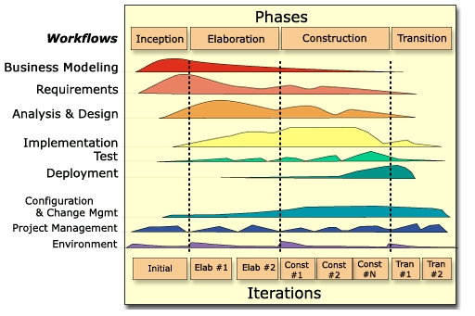
Testing throughout the Lifecycle – in Rational Unified Process (RUP)

Slide 51
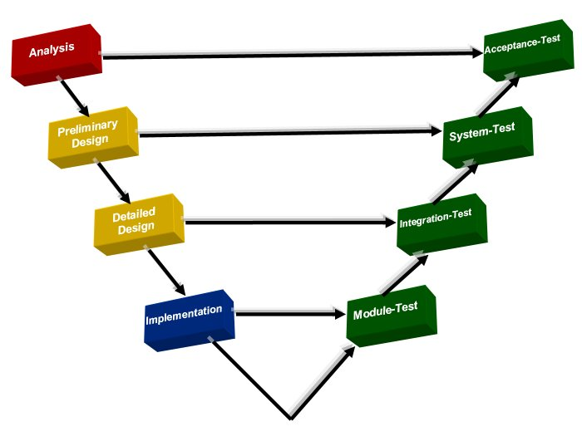
Testing throughout the Lifecycle – in the “V” model (half of this is about testing!)

Slide 52
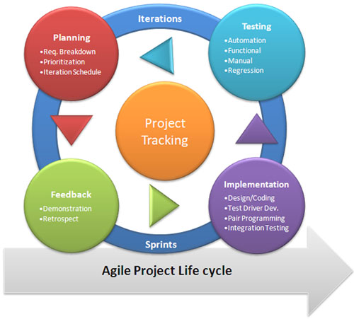
Testing throughout the Lifecycle – in Agile
Even here
(programmer testing)

Slide 53
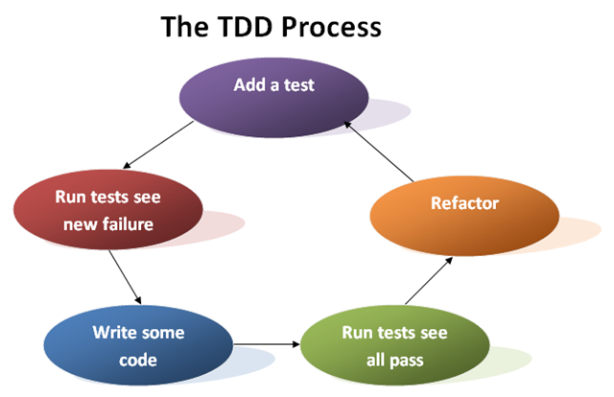
Testing throughout the Lifecycle – in TDD
(Test-Driven Development)
Step 1
In TDD, test cases are actually the requirements of the system.

Slide 54
Introduction to Software Testing- Outline
Definitions
Why is SW testing important?
Examples of Software Failures
Dealing with SW Faults
Testing Process Overview
What is a Test Case and Test Suite (Test Set)?
Types of Test Activities
Types of Testing
Test Levels/ Test Organization
Testing can be Manual or Automatic
What is a good test case?
Exhaustive (Complete) Testing
Test Adequacy and Coverage: When can we say testing is enough?
Testing throughout the Software Development Life Cycle
Testing Maturity Levels
Testing Roles

Slide 55
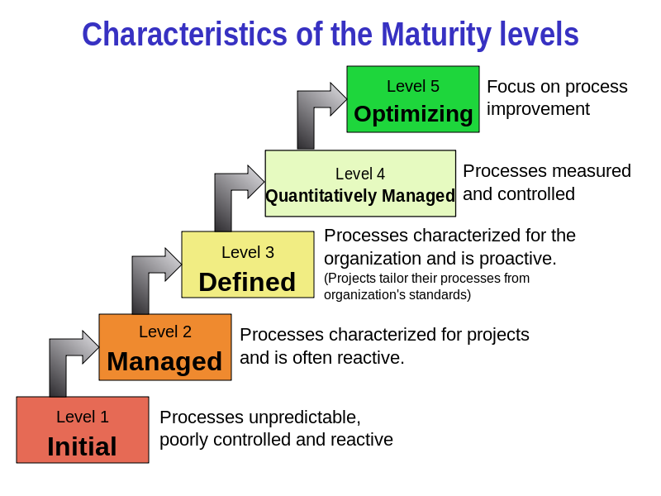
Testing Maturity Levels (in a company)
Testing Maturity Model Integration (TMMI) which is based on the Capability Maturity Model Integration (CMMI)
CMMI:

Slide 56
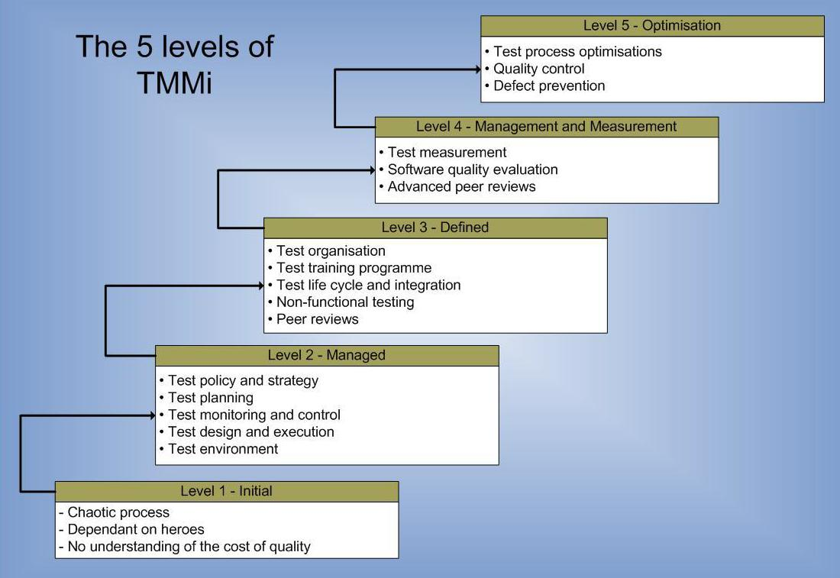
Testing Maturity Model Integration (TMMI)

Slide 57
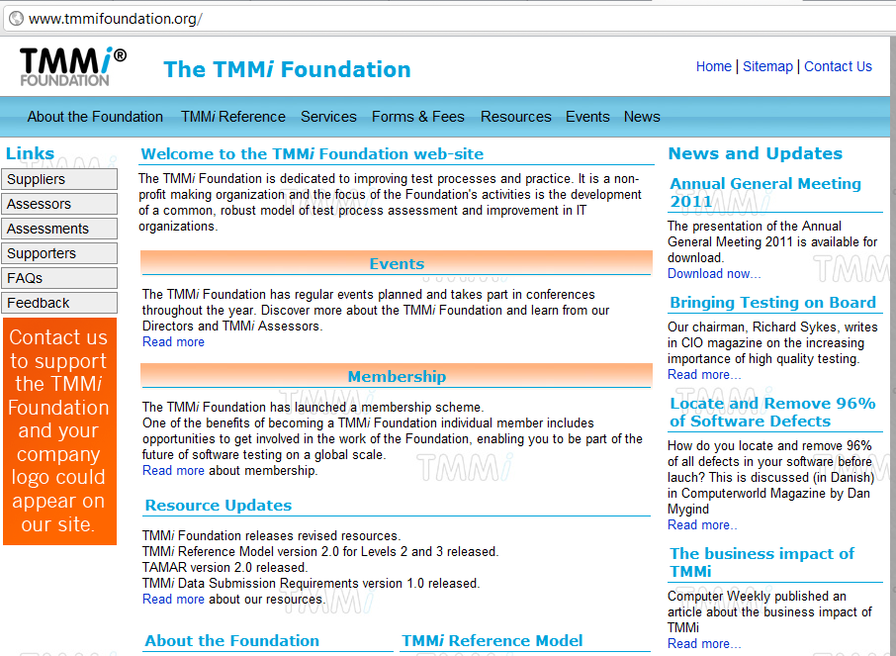

Slide 58
Introduction to Software Testing- Outline
Definitions
Why is SW testing important?
Examples of Software Failures
Dealing with SW Faults
Testing Process Overview
What is a Test Case and Test Suite (Test Set)?
Types of Test Activities
Types of Testing
Test Levels/ Test Organization
Testing can be Manual or Automatic
What is a good test case?
Exhaustive (Complete) Testing
Test Adequacy and Coverage: When can we say testing is enough?
Testing throughout the Software Development Life Cycle
Testing Maturity Levels
Testing Roles

Slide 59
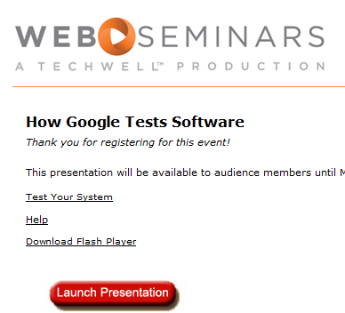
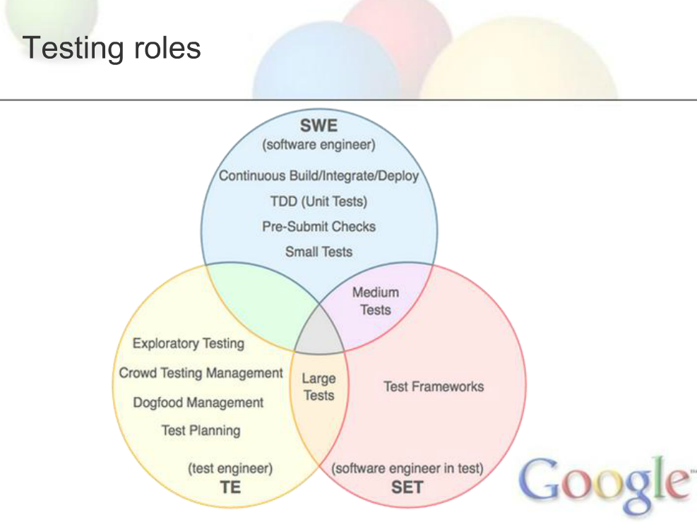
Also, called QA in many companies

Slide 60
SE 550-Software Engineering Black-box (Functional) Testing Vahid Garousi

Slide 61
Black-box Testing Basic Principles
Based on the definition of a program’s specification, as opposed to its structure (code, interface)
The notion of complete coverage can also be applied to functional (Black-box) testing
Rigorous specifications have another benefit, they help Black-box testing, e.g., categorize inputs, derive expected outputs
In other words, they help test case generation and test oracles

Slide 62
Black-box Testing: Different Techniques
Equivalence Class Partitioning
Pair-wise and n-way testing
Boundary-Value Analysis
Category-Partition
Decision tables
Cause-Effect Graphs

Slide 63
Black-box Testing: Outline
Equivalence Class Partitioning
Pair-wise and n-way testing
Boundary-Value Analysis
Category-Partition
Decision tables
Cause-Effect Graphs

Slide 64

Equivalence Class Testing
Motivation: we would like to have a sense of complete testing and we would hope to avoid test redundancy
Equivalence classes: partitions of the input set in which input data have the same effect on the program (e.g., the result in the same output)
Entire input set is covered: completeness
Disjoint classes: to avoid redundancy
Test cases: one element of each equivalence class
But equivalence classes have to be chosen wisely …
Guessing the likely system behavior might be needed
tc5
tc4
tc6
tc1
tc3
tc2
A SUT’s input set
Notes:
Inputs in an equivalence class are assumed to be “treated the same” by the system … this is the key to the definition of good equivalence classes

Slide 65
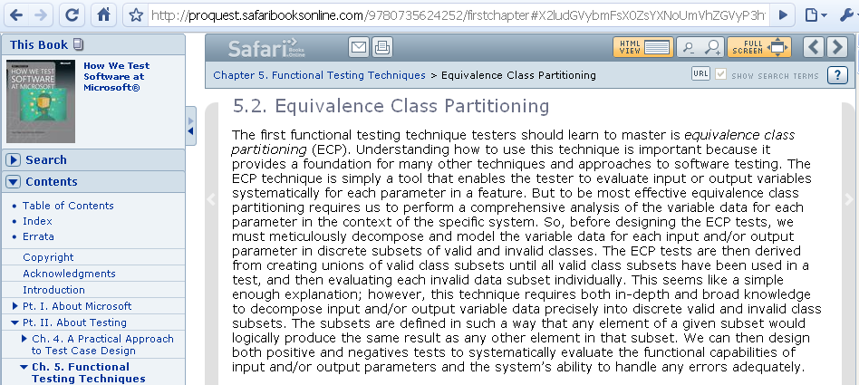
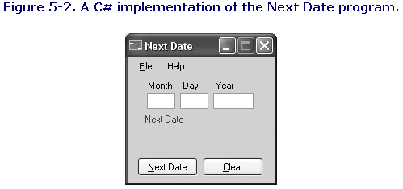
Companies are using Equivalence Class Testing!

Slide 66
Example of Equivalence Classes
NextDate is a function with three variables: month, day, year. It returns the date of the day after the input date. Limitation: years 1812-2020
Treatment Summary:
If it is not the last day of the month, the next date function will simply increment the day value.
At the end of a month, the next day is 1 and the month is incremented.
At the end of the year, both the day and the month are reset to 1, and the year incremented.
Finally, the problem of leap year makes determining the last day of a month interesting.
Definition of leap years (http://en.wikipedia.org/wiki/Leap_years): The Gregorian calendar adds a 29th day to February in all years evenly divisible by 4, except for centennial years (those ending in -00) which are not evenly divisible by 400. Thus 1600, 2000 and 2400 are leap years but 1700, 1800, 1900, 2100, 2200 and 2300 are not.
Only the year 1900 falls in the 1812-2020 period
Notes:
66
Since a year is 365.2422 days long, leap years are used for the extra data problem. If we declared a leap year every fourth year, there would be a slight error. A year is a leap year if it is divisible by 4, unless this is a century year. Century years are leap years only if they are multiples of 400. 1992, 1996, and 2000 are leap years, while the year 1900 is a common year.
The goal is to gain enough understanding about the problem to “guess” the different treatment inside the system … and then derive equivalence classes. May be discussed with domain experts – domain expertise is key here, though this example is obviously trivial.

Slide 67
NextDate Equivalence Classes
M1 = {month | month has 30 days}
M2 = {month | month has 31 days}
M3 = {month | month is February (the impact of leap years)}
D1 = {day | 1<= day <= 28}
D2 = {day | day = 29}= 29
D3 = {day | day = 30}=30
D4 = {day | day = 31}=31
Y1 = {year | year = 1900}= 1900
Y2 = {year | 1812 <= year <= 2012 AND (year != 1900) AND (year mod 4 = 0)}
Y3 = {year | (1812 <= year <= 2012 AND year mod 4 != 0 )}
Notes:
67
By selecting classes for 30 and 31, we simplify the last day of the month question
By taking February as a separate class, we can give more attention to leap year questions
Days in D1 are (nearly) always incremented while days in D4 only have meaning for months in M2
We have three classes of year, the special case of the year 1900, leap years, and common years.
This is not perfect but is likely to reveal many potential errors (implicit error model in mind, e.g., missing leap year, wrong #days in month, etc.)

Slide 68

Weak/Strong Equivalence Class Testing
For an example SUT, suppose there are three input variables from three domains: A, B, C
A = A₁ ∪ A₂ ∪ A₃ ∪ … ∪ A_{m} where a_{i}∈A_{i}
B = B₁ ∪ B₂ ∪ B₃ ∪ … ∪ B_{n} where b_{i}∈B_{i}
C = C₁ ∪ C₂ ∪ C₃ ∪ … ∪ C_{o} where c_{i}∈C_{i}
Weak Equivalence Class Testing: Choosing one variable value form each equivalence class (one a_{i}, b_{i}, and c_{i}) such that all classes are covered. # of test cases?
max (|A|, |B|, |C|)
Strong Equivalence Class Testing: Is based on the Cartesian product of the partition subsets (A×B×C), i.e., testing all interactions of all equivalence classes. # of test cases?
|A| x |B| x |C|
Examples next…
A
B
C

Slide 69
Example of Weak Equivalence Class Testing (WECT)
For an example SUT, suppose there are three input variables from three domains: A, B, C
A = A₁ ∪ A₂ ∪ A₃ where a_{i}∈A_{i}
B = B₁ ∪ B₂ ∪ B₃ ∪ B₄ where b_{i}∈B_{i}
C = C₁ ∪ C₂ where c_{i}∈C_{i}
Number of WETCs needed=Max size w.r.t. the number of equivalence classes of {A, B, C}
4 WETCs are enough.
_{Test Case} | _{A} | _{B} | _{C}
_{WETC1} | _{a1} | _{b1} | _{c1}
_{WETC2} | _{a2} | _{b2} | _{c2}
_{WETC3} | _{a3} | _{b3} | _{c1}
_{WETC4} | _{a1} | _{b4} | _{c2}
Notes:
From Jorgensen, Software Testing, A Craftman’s Approach, 1995
As many test cases as the partition with the largest number of equivalence classes

Slide 70
Example of Strong Equivalence Class Testing (SECT)
|A| (number of equivalence classes) = 3
|B| = 4
|C| = 2
# of test cases=3x4x2=24
_{Test Case} | _{A} | _{B} | _{C}
_{SETC1} | _{a1} | _{b1} | _{c1}
_{SETC2} | _{a1} | _{b1} | _{c2}
_{SETC3} | _{a1} | _{b2} | _{c1}
_{SETC4} | _{a1} | _{b2} | _{c2}
_{SETC5} | _{a1} | _{b3} | _{c1}
_{SETC6} | _{a1} | _{b3} | _{c2}
_{SETC7} | _{a1} | _{b4} | _{c1}
_{SETC8} | _{a1} | _{b4} | _{c2}
_{SETC9} | _{a2} | _{b1} | _{c1}
_{SETC10} | _{a2} | _{b1} | _{c2}
_{SETC11} | _{a2} | _{b2} | _{c1}
_{SETC12} | _{a2} | _{b2} | _{c2}
_{SETC13} | _{a2} | _{b3} | _{c1}
_{SETC14} | _{a2} | _{b3} | _{c2}
_{SETC15} | _{a2} | _{b4} | _{c1}
_{SETC16} | _{a2} | _{b4} | _{c2}
_{SETC17} | _{a3} | _{b1} | _{c1}
_{SETC18} | _{a3} | _{b1} | _{c2}
_{SETC19} | _{a3} | _{b2} | _{c1}
_{SETC20} | _{a3} | _{b2} | _{c2}
_{SETC21} | _{a3} | _{b3} | _{c1}
_{SETC22} | _{a3} | _{b3} | _{c2}
_{SETC23} | _{a3} | _{b4} | _{c1}
_{SETC24} | _{a3} | _{b4} | _{c2}
Notes:
From Jorgensen, Software Testing, A Craftman’s Approach, 1995
Product of equivalence classes: 3 * 4 * 2 = 24 elements / test cases, a 6-fold increase in test cases!
Note: Should be capital letters!!! Like the previous slide

Slide 71
NextDate Equivalence Classes
M
M1 = {month | month has 30 days}
M2 = {month | month has 31 days}
M3 = {month | month is February (the impact of leap years)}
D1 = {day | 1<= day <= 28}
D2 = {day | day = 29}
D3 = {day | day = 30}
D4 = {day | day = 31}
Y1 = {year | year = 1900}
Y2 = {year | 1812 <= year <= 2012 AND (year != 1900) AND (year mod 4 = 0)}
Y3 = {year | (1812 <= year <= 2012 AND year mod 4 != 0 )}
D
Y
Notes:
By selecting classes for 30 and 31, we simplify the last day of the month question
By taking February as a separate class, we can give more attention to leap year questions
Days in D1 are (nearly) always incremented while days in D4 only have meaning for months in M2
We have three classes of year, the special case of the year 1900, leap years, and common years.
This is not perfect but is likely to reveal many potential errors (implicit error model in mind, e.g., missing leap year, wrong #days in month, etc.)

Slide 72
NextDate Weak Equivalence Class Testing (WECT) - Test Cases
Number of WECT test cases=maximum partition size (D)=4
Test Case ID | Month | Day | Year | Output
WETC1 | 6 | 14 | 1900 | 6/15/1900
WETC2 | 7 | 29 | 1912 | 7/30/1912
WETC3 | 2 | 30 | 1913 | Invalid Input date (not possible)
WETC4 | 5 | 31 | 1900 | Invalid Input date
Notes:
SETC not perfect but still much more thorough than WETC
Potential problem: with the equivalence classes as defined, we may not have a Feb 28 in the test cases
If we had chosen 5 day classes where D’1 would be 1-27 and D’’1 would be 28, and the other three would stay the same, we would have 45 test cases and a better coverage of the Feb 28 potential problem
Another possibility might be that we decide that most test cases related to 1900 are not that interesting and 1900 would be merged with other non-leap years. It would bring the test cases to 24
Such test cases may be systematically reused/rerun after each modification of the system (maintenance): regression testing. Trying to minimize them is therefore important.

Slide 73
NextDate Strong Equivalence Class Testing (SECT) - Test Cases
Number of SECT test cases= partition size (D) x partition size (M) x partition size (Y) = 3x4x3=36 test cases
_{Test Case ID} | _{Month} | _{Day} | _{Year} | _{Expected Output}
_{SE1} | ₆ | ₁₄ | ₁₉₀₀ | _{6/15/1900}
_{SE2} | ₆ | ₁₄ | ₁₉₁₂ | _{6/15/1912}
_{SE3} | ₆ | ₁₄ | ₁₉₁₃ | _{6/15/1913}
_{SE4} | ₆ | ₂₉ | ₁₉₀₀ | _{6/30/1900}
_{SE5} | ₆ | ₂₉ | ₁₉₁₂ | _{6/30/1912}
_{SE6} | ₆ | ₂₉ | ₁₉₁₃ | _{6/30/1913}
_{SE7} | ₆ | ₃₀ | ₁₉₀₀ | _{7/1/1900}
_{SE8} | ₆ | ₃₀ | ₁₉₁₂ | _{7/1/1912}
_{SE9} | ₆ | ₃₀ | ₁₉₁₃ | _{7/1/1913}
_{SE10} | ₆ | ₃₁ | ₁₉₀₀ | _{ERROR}
_{SE11} | ₆ | ₃₁ | ₁₉₁₂ | _{ERROR}
_{SE12} | ₆ | ₃₁ | ₁₉₁₃ | _{ERROR}
_{SE13} | ₇ | ₁₄ | ₁₉₀₀ | _{7/15/1900}
_{SE14} | ₇ | ₁₄ | ₁₉₁₂ | _{7/15/1912}
_{SE15} | ₇ | ₁₄ | ₁₉₁₃ | _{7/15/1913}
_{SE16} | ₇ | ₂₉ | ₁₉₀₀ | _{7/30/1900}
_{SE17} | ₇ | ₂₉ | ₁₉₁₂ | _{7/30/1912}
_{SE18} | ₇ | ₂₉ | ₁₉₁₃ | _{7/30/1913}
_{SE19} | ₇ | ₃₀ | ₁₉₀₀ | _{7/31/1900}
_{SE20} | ₇ | ₃₀ | ₁₉₁₂ | _{7/31/1912}
_{SE21} | ₇ | ₃₀ | ₁₉₁₃ | _{7/31/1913}
_{SE22} | ₇ | ₃₁ | ₁₉₀₀ | _{8/1/1900}
_{SE23} | ₇ | ₃₁ | ₁₉₁₂ | _{8/1/1912}
_{SE24} | ₇ | ₃₁ | ₁₉₁₃ | _{8/1/1913}
_{SE25} | ₂ | ₁₄ | ₁₉₀₀ | _{2/15/1900}
_{SE26} | ₂ | ₁₄ | ₁₉₁₂ | _{2/15/1912}
_{SE27} | ₂ | ₁₄ | ₁₉₁₃ | _{2/15/1913}
_{SE28} | ₂ | ₂₉ | ₁₉₀₀ | _{ERROR}
_{SE29} | ₂ | ₂₉ | ₁₉₁₂ | _{3/1/1912}
_{SE30} | ₂ | ₂₉ | ₁₉₁₃ | _{ERROR}
_{SE31} | ₂ | ₃₀ | ₁₉₀₀ | _{ERROR}
_{SE32} | ₂ | ₃₀ | ₁₉₁₂ | _{ERROR}
_{SE33} | ₂ | ₃₀ | ₁₉₁₃ | _{ERROR}
_{SE34} | ₂ | ₃₁ | ₁₉₀₀ | _{ERROR}
_{SE35} | ₂ | ₃₁ | ₁₉₁₂ | _{ERROR}
_{SE36} | ₂ | ₃₁ | ₁₉₁₃ | _{ERROR}
Notes:
From Jorgensen, Software Testing, A Craftman’s Approach, 1995

Slide 74
Equivalence Class Testing NextDate Example - Discussion
If error conditions are a high priority, we should extend strong equivalence class testing to include invalid classes
E.g., year | year < 1812 or year > 2012
Equivalence Class Testing is appropriate when input data defined in terms of ranges and sets of discrete values
We can also consider extra equivalence classes to consider the “invalid” situations, e.g., years before 1812 or after 2012
Notes:
We have not included invalid equivalence classes in the previous example … like years before 1812 or after 2012

Slide 75
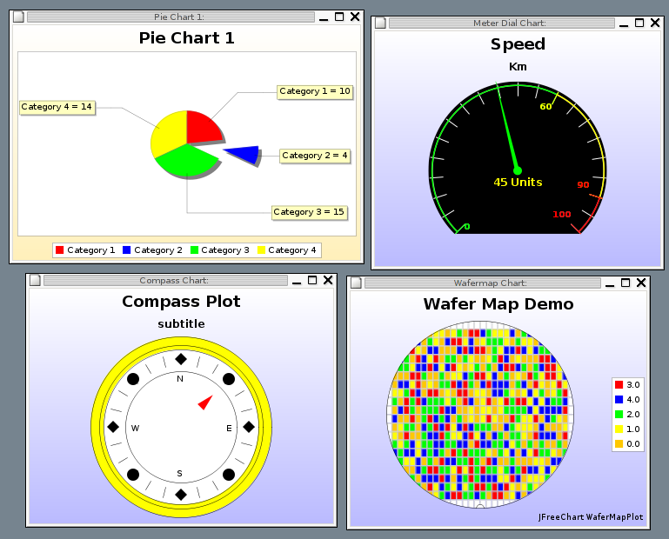
Equivalence Class Testing – Class Exercise JFreeChart
We will test this system in lab #2
http://www.jfree.org/jfreechart
The JFreeChart framework is a free/open-source library intended to be integrated into other systems as a quick and simple way to add charting functionality to Java applications.

Slide 76
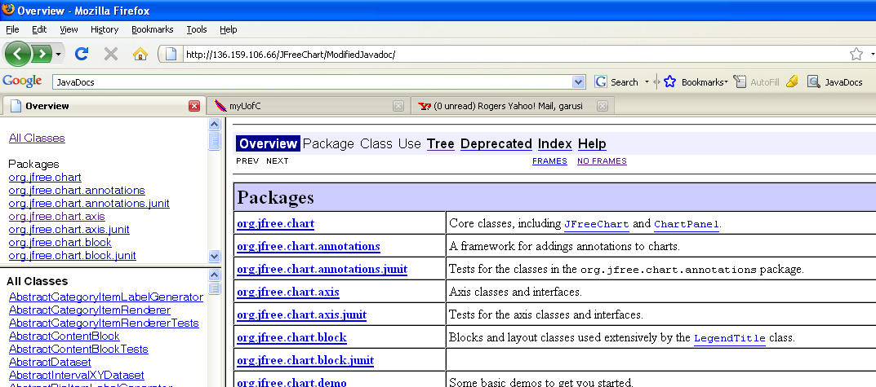
JFreeChart – Requirements
Reminder: SW Requirements can come in many different formats, e.g., plain English, UML models, Javadoc, …
In lab #2, we will use the Javadoc documentation of JFreeChart as its requirements
Start reviewing the lab #2 document and the JFreeChart Javadoc after the class (are online).

Slide 77
Lab #2 - JFreeChart – Classes to test based on requirements
org.jfree.data.DataUtilities: Has 5 methods (details next)
org.jfree.data.Range…
org.jfree.data.io.CSV…

Slide 78
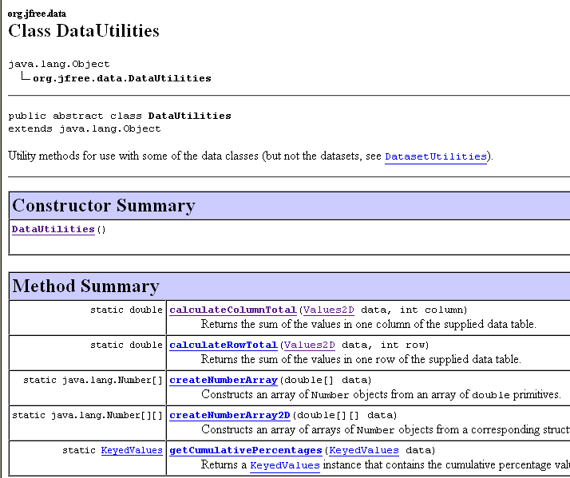
JFreeChart – Class org.jfree.data.DataUtilities Has 5 methods…
Let’s apply equivalence partitioning testing to this method (NEXT).
The rest will be done in lab #2

Slide 79
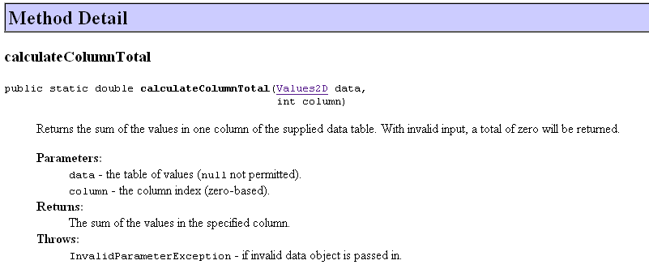

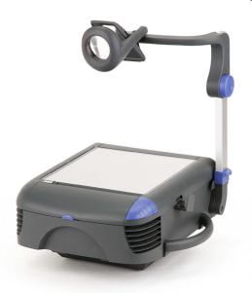
Systematic procedure for equivalence partitioning Class org.jfree.data.DataUtilities
Identify the input domain
We should start from the Requirements (in Javadoc format)
Exercise: What is the input domain of method calculateColumnTotal?

Slide 80
Systematic procedure for equivalence partitioning JFreeChart – Class org.jfree.data.DataUtilities
Equivalence classing
Let’s draw the equivalence classes diagram for method calculateColumnTotal?

Slide 81

Systematic procedure for equivalence partitioning JFreeChart – Class org.jfree.data.DataUtilities
Combine equivalence classes:
We should use either Weak Equivalence Class Testing (WECT) (one-dimensional), or Strong … (SECT) (multi-dimensional)
Also, specify the expected output for each test case.
Hint: In Java, InvalidParameterException (which extends IllegalArgumentException) should be thrown (by our code) when an invalid parameter is passed to a method.

Slide 82
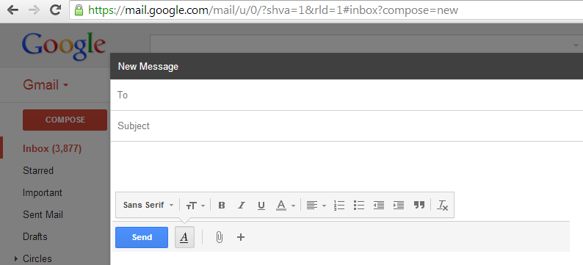
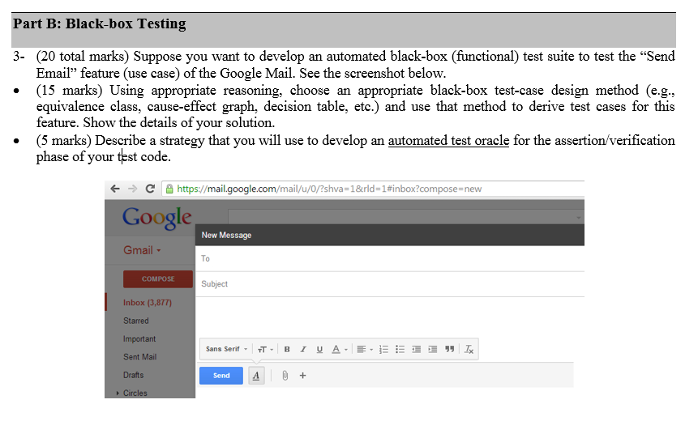
Exercise
Use equivalence-class testing to develop an automated black-box (functional) test suite to test the “Send Email” feature (use case) of the Google Mail. See the screenshot below.
Was in exam a few years ago!

Slide 83
Black-box Testing: Outline
Equivalence Class Partitioning
Boundary-Value Analysis
Category-Partition
Decision tables
Cause-Effect Graphs

Slide 84
Boundary-Value Analysis Motivations
In equivalence class testing, we partitioned input domains into equivalence classes, on the assumption that the behavior of the program is “similar” for all input values of a equivalence class
But the above assumption may not be true in all cases as…
Some typical programming errors happen to be at the boundary between different equivalence classes
This is what boundary value testing
focuses on
Simpler but complementary to
equivalence class testing

Slide 85
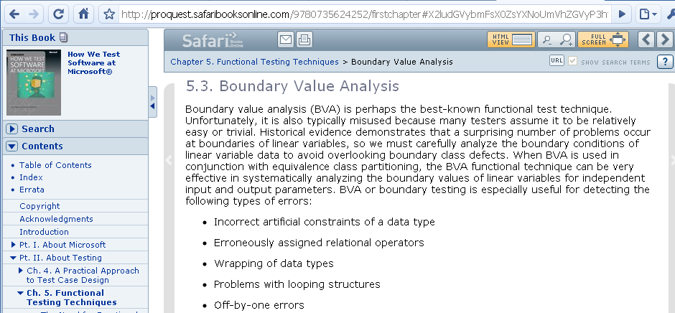

Slide 86
Boundary-Value Analysis Basic Ideas
Assume a function F, with two variables x1 and x2
(Possibly unstated) boundaries: a <= x1 <= b, c <= x2 <= d
In some programming languages, strong typing allows the specification of such intervals
In boundary-value analysis (and testing), the focus is on the boundary of the input space for identifying test cases
The rationale is that errors tend to occur near extreme values of input variables

Slide 87
Boundary-Value Analysis Basic Ideas
Approach: Setting values for input variable at their minimum, just above the minimum, a nominal value, just below their maximum, and at their maximum.
Convention for the above notions:
min, min+, nom, max-, max
A usual strategy for all input variables: Holding the values of all but one variable at their nominal values, letting one variable assume its extreme value
Examples next…
Notes:
There exist a tool integrated into case tools such as Software Through Pictures and Teamwork for boundary testing

Slide 88
Boundary-Value Analysis Input Domain of Function F
Assume a function F, with two variables x1 and x2, domains X1 and X2
(Possibly unstated) boundaries: a <= x1 <= b, c <= x2 <= d
X2
d
c
X1
a
b

Slide 89
Boundary-value Analysis Test Cases
Test set ={ <x1_{nom}, x2_{min}>, <x1_{nom}, x2_{min+}>, <x1_{nom}, x2_{nom}>, <x1_{nom}, x2_{max-}>, <x1_{nom}, x2_{max}>, <x1_{min}, x2_{nom},>, <x1_{min+}, x2_{nom},>, <x1_{max-}, x2_{nom}>, <x1_{max}, x2_{nom}>}.
Number of test cases=9
X2
d
c
a
b
X1
min min+ nom max- max

Slide 90
Boundary-Value Analysis General Case and Limitations
A function with n variables will require 4n + 1 test cases
Works well with variables that represent bounded physical quantities
No consideration of the nature of the function and the meaning of variables
An elementary technique that is a extendable to robustness testing (next)
“Robustness is defined as the degree to which a system operates correctly in the presence of exceptional inputs or stressful environmental conditions.” [IEEE Standard 610.12.1990]
The goal of robustness testing is to develop test cases and test environments where a system's robustness can be assessed.

Slide 91
Boundary-Value Analysis: The relationship with Robustness Testing
In Robustness Testing, We also look at the behavior of the system when the variable extremes are exceeded with a value slightly greater than the maximum (max+) and a value slightly less than the minimum (min-)
This is an extension of the basic boundary-value testing.
A function with n variables will require 6n + 1 test cases
X2
d
min- min min+ nom max- max max+
c
X1
a
b
min- min min+ nom max- max max+

Slide 92
Boundary-Value Analysis Worst Case Testing (WCT)
Boundary-value makes the common assumption that failures, most of the time, originate from one fault
What happens when more than one variable has an extreme value?
The idea comes from electronics in circuit analysis
Cartesian product of {min, min+, nom, max-, max}
Clearly more thorough than boundary-value analysis, but with much more effort: 5^{n} test cases (n: number of variables)
WCT is a good strategy when physical variables have numerous interactions, and where failure is costly
X2
d
c
X1
a
b
Notes:
5 power n yields much larger test sets than previous test criteria e.g., 4 times n + 1)

Slide 93
Boundary-Value Analysis Even further: Robust Worst-Case Testing for 2 variables
7^{n} test cases (n: number of variables)
X2
d
c
X1
a
b
Notes:
For paranoid testing!
Combine robustness testing and WCT!

Slide 94
Black-box Testing: Outline
Equivalence Class Partitioning
Pair-wise and n-way testing
Boundary-Value Analysis
Category-Partition Testing
Decision tables
Cause-Effect Graphs

Slide 95
Category-Partition Testing Steps
The system is divided into individual “functions” that can be independently tested
The method identifies the parameters of each “function” and, for each parameter, identifies distinct categories
Besides parameters, environment characteristics, under which the function operates (characteristics of the system state), can also be considered
Categories are major properties or characteristics for each parameter
The categories are further subdivided into choices in the same way as equivalence partitioning is applied (possible “values”)
A broader idea compared to Equivalence-Class Partitioning. (see the notes area)
In essence: Category-partition testing integrates equivalence class testing, boundary analysis, and adds a few refinements
Notes:
Ostrand and Balcer, Communications of the ACM, 1988
Category-partition testing integrates equivalence class testing, boundary analysis, and add a few refinements:
Explicit dependencies between equivalence classes (here called “choices”)
An additional step, categories, where the characteristics considered go beyond partitioning input domains, e.g., accounting for environment characteristics that may affect the execution of the function under test

Slide 96
Category-Partition Testing An Example
Specification: The program prompts the user for a positive integer in the range 1 to 20 and then for a string of characters of that length.
The program then prompts for a character and returns either the position in the string at which the character was first found or a message indicating that the character was not present in the string.
The user has the option to search for more characters.
Notes:
96
Very exciting example! ☺

Slide 97
Category-Partition Testing Example Parameters and Categories
Parameters: Three
integer x (length), the string a, and the character c
Categories:
For the length x, the categories are “in-range” (1-20) or “out-of-range”
Categories for the string a: minimal, maximal, intermediate length
Categories for character c: character appears at the beginning, middle, end of string, or does not occur in the string

Slide 98
Category-Partition Testing Example Choices
For Integer x, out-of-range: 0, 21
For Integer x, in-range: 1, 2-19, 20
For String a: 1, 2-19, 20
For Character c: first, middle, last, does not occur
Note: sometimes we can have only one choice in each category
Notes:
Sometimes one choice in category (e.g., a, c)
Combined boundary analysis, robustness and equivalence class partitioning (on categories!) here

Slide 99
Category-Partition Testing Example Formal Test Specifications with Constraints
Recall the definition of dependent and independent variables from statistics
x (length):
1) 0 [error (out of range)]
2) 1 [property stringOk, MinLength]
3) 2-19 [property stringOk, MidLength]
4) 20 [property stringOk, MaxLength]
5) 21 [error (out of range)]
a (string):
Of length 1 [if stringOk and MinLength]
Of length 2-19 [if stringOk and MidLength]
Of length 20 [if stringOk and MaxLength]
c (character):
At first position in string [if stringOk]
At last position in string [if stringOk and not MinLength]
3) In middle of string [if stringOk and not MinLength]
4) Not in string [if stringOk]
independent
Choices
dependent
Choices
Choices
Notes:
Dependencies are explicit and can be discussed, reviewed …
This is where you specify, in an unambiguous way, your testing (during test planning)
This is done once the function specifications are available, long before actual test cases are run
It helps better prepare testing, when the pressure to complete will be high
In this example, the test specification could have been different – we could test more thoroughly error cases (incompatible choices due to user errors) to test the system robustness to corrupt/inconsistent inputs
Property stringOK is not really necessary as we use [error] in other cases

Slide 100
Category-Partition Testing Specifying constraints among choices, in General
Properties, and Selectors are associated with choices
Category A
ChoiceA1 [property X, Y, Z]
ChoiceA2
Category B
ChoiceB1
ChoiceB2 [if X and Z]
E.g., in the above abstract example, ChoiceA2 and ChoiceB2 would not be combined into a test frame
3 properties (definitions)
Choices
A selector
Notes:
100
Specific formalism is used here
We want to reduce the number of test cases, especially in the context of large applications
Choices are annotated with constraints, consisting of properties and selectors based on properties
Here, in this abstract example, choiceA2 and choiceB2 would not be combined into a test frame
Special selectors:
[error] exception or error state not to be combined with other choices in other categories (e.g., can be tested once), e.g., date before 1812 in the NewDate example. Any call to the function using that choice will result in the same error.
[single] special choices which again do not have to be combined with any others, e.g., illegal, special, unusual, redundant cases, e.g., 1900 in the NewDate example
With [single], the tester is making an (explicit) judgment that this choice can be adequately tested with one test case.

Slide 101
Category-Partition Testing Example Test Frames, Data and Cases
The number depends on the inter-choice constraint dependencies
Without constraints: 5*3*4 = 60 test frames/cases (i.e., using SECT)
We have reduced to 12 using constraints
x (length):
1) 0 [error (out of range)]
2) 1 [property stringOk, MinLength]
3) 2-19 [property stringOk, MidLength]
4) 20 [property stringOk, MaxLength]
5) 21 [error (out of range)]
a (string):
Of length 1 [if stringOk and MinLength]
Of length 2-19 [if stringOk and MidLength]
Of length 20 [if stringOk and MaxLength]
c (character):
At first position in string [if stringOk]
At last position in string [if stringOk and not MinLength]
3) In middle of string [if stringOk and not MinLength]
4) Not in string [if stringOk]
x1 x = 0
x2a1c1 x = 1, a = ‘A’, c = ‘A’
x2a1c4 x = 1, a = ‘A’, c = ‘B’
x3a2c1 x = 7, a = ‘ABCDEFG’, c = ‘A’
x3a2c2 x = 7, a = ‘ABCDEFG’, c = ‘G’
x3a2c3 x = 7, a = ‘ABCDEFG’, c = ‘D’
x3a2c4 x = 7, a = ‘ABCDEFG’, c = ‘X’
x4a3c1 x = 20, a = ‘ABCDEFGHIJKLMNOPQRST’, c = ‘A’
x4a3c2 x = 20, a = ‘ABCDEFGHIJKLMNOPQRST’, c = ‘T’
x4a3c3 x = 20, a = ‘ABCDEFGHIJKLMNOPQRST’, c = ‘J’
x4a3c4 x = 20, a = ‘ABCDEFGHIJKLMNOPQRST’, c = ‘X’
x5 x = 21
Notes:
101
Without constraints: 5*3*4 = 60 test frames/cases
We have reduced to 12 using constraints

Slide 102
Category-Partition Testing Steps (II)
The constraints operating between choices are then identified, i.e., how the occurrence of one choice can affect the existence of another
E.g., in the array sorting example, if Len = 0, then the rest does not matter
Test frames (or test specifications) are then generated which are defined as the allowable combinations of choices in the categories
Test frames are then converted into test data

Slide 103
Category-Partition Testing Criteria Using Choices
All Combinations (AC): This is what was shown in the previous example, what is typically done when using category-partition. One value for every choice of every parameter must be used with one value of every (possible) choice of every other category.
Each choice (EC): This is a weaker criterion. One value from each choice for each category must be used at least in one test case.
Should use a “greedy approach”
How many test cases for our example? 7 TCs
x1 x = 0
x2a1c1 x = 1, a = ‘A’, c = ‘A’
x2a1c4 x = 1, a = ‘A’, c = ‘B’
x3a2c1 x = 7, a = ‘ABCDEFG’, c = ‘A’
x3a2c2 x = 7, a = ‘ABCDEFG’, c = ‘G’
x3a2c3 x = 7, a = ‘ABCDEFG’, c = ‘D’
x3a2c4 x = 7, a = ‘ABCDEFG’, c = ‘X’
x4a3c1 x = 20, a = ‘ABCDEFGHIJKLMNOPQRST’, c = ‘A’
x4a3c2 x = 20, a = ‘ABCDEFGHIJKLMNOPQRST’, c = ‘T’
x4a3c3 x = 20, a = ‘ABCDEFGHIJKLMNOPQRST’, c = ‘J’
x4a3c4 x = 20, a = ‘ABCDEFGHIJKLMNOPQRST’, c = ‘X’
x5 x = 21

Slide 104
Category-Partition Testing Conclusions
Identifying parameters and environments conditions, and categories, heavily relies on the experience of the tester
Makes testing decisions explicit (e.g., constraints), open for review
Combines boundary-value analysis, robustness testing, and equivalence-class partitioning
Once the first step (i.e., specifying the constraints) is completed, the technique is straightforward and can be automated
The criteria for test-case reduction makes it useful for practical testing
Source:
Notes:
We have seen a simple example so you might wonder why so much effort for such a simple piece of program. But of course such techniques are designed for testing larger, more complex, possibly more critical functionalities.

Slide 105
Black-box Testing: Outline
Equivalence Class Partitioning
Pair-wise and n-way testing
Boundary-Value Analysis
Category-Partition Testing
Decision tables
Cause-Effect Graphs

Slide 106
Decision Tables - Motivations
To help express test requirements in a directly usable form
Easy to understand and support the systematic derivation of test cases
To support automated or manual generation of test cases
A particular response or response subset is to be selected for testing by evaluating many related conditions
Ideal for describing situations in which a number of combinations of actions are taken under varying sets of conditions, e.g., control systems

Slide 107
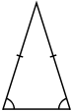
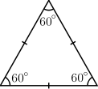

Decision Tables - An Example For a program identifying the type of a triangle given its edge (side) sizes
a
b
Equilateral | Isosceles | Scalene
c
Conditions
Decisions
Actions
Notes:
107
From Jorgensen, Software Testing, A Craftman’s Approach, 1995
This is the decision table for a program that determines the type of a triangle (if a triangle) based on the lengths of the triangle’s sides …
Test case generation: we interpret conditions as conditions on inputs and actions as outputs or change of system state. Sometimes, conditions end up referring to equivalence classes of inputs and actions refer to major functional processing portions of the item being tested (testing in the large). In this case, conditions are mutually exclusive.
Rules are then interpreted as test cases – because the table can mechanically be forced to be complete, we have a “complete” set of test cases
Note: actions can be added to match impossible cases (related to exception handling)
Here examples of “don’t care” entry and impossible rule usage
In rules 3, 4, and 6, if two pairs are equal, by transitivity, the third pair must be equal.

Slide 108
Decision Tables - Structure
There is a condition section which lists conditions and combinations thereof
Conditions express relationships among decision variables
There is an Action section which lists responses to be produced when corresponding combinations of conditions are true
A limitation: Resultant actions are determined by the current values of decision variables!
Actions are independent of input order and the order in which conditions are evaluated
Actions may appear more than once but each combination of conditions is unique
Notes:
It is not very effective to model memory as decision variables …. See state machine models
E.g.: credit line extension decision depends not only on current account characteristics and status but also on account history – more difficult to model with decision table
e.g.: a temperature control system using room temperature and user set temperature to control heating does not use history – easier to model with decision table
Input order may be important when inputs are event occurences, that have an order of arrival

Slide 109
Decision Tables - Table Structure
Notes:
From Jorgensen, Software Testing, A Craftman’s Approach, 1995
This is ONE possible format for decision tables
A column in the entry portion is a rule
Rules indicate which actions are taken for the conditional circumstances indicated in the condition portion of the rule: C1=T AND C2=T AND C3=F => a1, a3
“-” represent the “don’t care” entry, the condition is irrelevant or does not apply, sometimes “n/a” is used for the latter interpretation
The structure guarantees that every combination of condition values are considered -> will help with “complete” test case generation
Actions are not specified to occur in any particular order in decision tables
Here is an example where conditions are binary, but they do not have to be: limited entry decision tables versus extended entry decision tables

Slide 110
Decision Tables - An Example Can also be shown as a conventional Truth Table
Notes:
Another way of representing the triangle decision table … less readable but possibly more adapted to cases with many conditions
Directly exploitable for test case generation
Refinement of the first condition here: 3 conditions for “ a, b, c are a triangle?”
11 categories of test cases: total coverage -> minimum of 11 test cases

Slide 111
Decision Tables - An Example Test Cases
One test case for each test rule from the corresponding truth table.
A test rule
11 test rules…
Notes:
We obtain 11 test cases: three impossible cases (?), three ways to fail the triangle property, one way to get an equilateral triangle, one way to get a scalene triangle, and three ways to get an isosceles triangle
Impossible cases cannot be entered by the user (obviously) but may be the result of a bug in the condition implementations. The system may still need to be robust to it and detect it.

Slide 112
Decision Tables - Ideal Usage Conditions
One of several distinct responses (i.e., actions) is to be selected according to distinct cases of input variables
These cases can be modeled by mutually-exclusive Boolean expressions on the input variables
The response to be produced does not depend on the order in which input variables are set or evaluated (e.g., events are received)
The response does not depend on prior inputs or outputs
Notes:
Responses: outputs, changes to system state

Slide 113
Decision Tables - Explosion of Condition Variants
For n conditions, there may be at most 2^{n} variants (unique combinations of conditions and actions)
Our triangle Example…
But, fortunately, there are usually much fewer explicit variants in SW systems…
“Don’t care” values in decision tables help reduce the number of those variants
“Don’t care” can correspond to several cases:
The inputs are necessary but have no effect
The inputs may be omitted
Notes:
A variant that can be inferred but is not given is an implicit variant.
Results from don’t care and type-safe exclusions (e.g., logically, mutually exclusive conditions such as different value intervals for a variable)

Slide 114
Black-box Testing: Outline
Equivalence Class Partitioning
Pair-wise and n-way testing
Boundary-Value Analysis
Category-Partition Testing
Decision tables
Cause-Effect Graphs

Slide 115
Cause-Effect Graphs Car Insurance Renewal Example
Causes
Effects
Age: 25-
Renewal cost=$25
Age: 26+
$50
0 Claims
$100
1 Claim
$200
2-4 Claims
$400
Warning
5+ Claims
Cancel
Notes:
115
Intermediary nodes (grey) help simplify graphs, from a visual standpoint
Decision variables are Age and Claims

Slide 116
Cause-Effect Graphs Definition
Graphical technique that helps derive decision tables
Aim at supporting interaction with domain experts and the reverse engineering of specifications, for the purpose of testing.
Identify causes (conditions on inputs, stimuli) and effects (outputs, changes in system state)
Causes have to be stated in such a way to be either true or false (Boolean expression)
Can be used to explicitly specify constraints (environmental, external) on causes and effects
They can help select more “significant” subset of input-output combinations and build smaller decision tables
Notes:
The main difference with equivalence-class testing and category-partition testing is that outputs or actions are taken into account when identifying test requirements

Slide 117
Cause-Effect Graphs Structure of
A node is drawn for each cause and effect
Nodes placed on opposite side of a sheet
An edge from a cause to an effect indicates that the cause is a necessary condition for the effect
If a single effect has two or more causes, the logical relationship of the causes is annotated by symbols for logical and (^) and logical or (∨) placed between lines
A cause whose negation is necessary is shown by a logical not (~)
A single cause may be necessary for many effects; a single effect may have many necessary causes.
Intermediate nodes may be used to simplify the graph and its construction

Slide 118
Cause-Effect Graphs Notations in
If A then B
A
B
A
AND: If (A and B) then C
C
B
A
OR: If (A or B) then C
C
B
A
NAND: If not (A and B) then C
C
B
A
NOR: If (neither A nor B) then C
C
B
A
B
NOT: If (not A) then B
Notes:
Nodes: Causes on the left, effects on the rights
Links: cause-effect relationships
Some people use circuit logic notation (logic gates), but this is the standard notation

Slide 119
From “Cause-Effect Graphs” to “Decision Tables” Car Insurance Renewal Example
Age: 25-
Renewal cost=$25
Age: 26+
$50
0 Claims
$100
1 Claim
$200
Identical
2-4 Claims
$400
Warning
5+ Claims
Cancel
 | Condition Section |  | Action Section
Variant | Claims | Age | Premium Increase $ | Send Warning | Cancel
1 | 0 | 25- | 50 | No | No
2 | 0 | 26+ | 25 | No | No
3 | 1 | 25- | 100 | Yes | No
4 | 1 | 26+ | 50 | No | No
5 | 2 to 4 | 25- | 400 | Yes | No
6 | 2 to 4 | 26+ | 200 | Yes | No
7 | 5+ | Any | 0 | No | Yes
Notes:
Variants can also be columns, or a decision tree format can be used. More readable but tables are more readily implemented as data structures used in test automation. The systematic enumeration of variants in tables makes it less likely to omit a case.

Slide 120
Cause-Effect Graphs Additional Constraints
A
Exactly one of A and B must be true
O
B
A
At most one of A and B may be true
(E should be remembered!)
E
B
I
A
At least one of A and B must be true
B
A
A masks B, i.e., A => NOT B
M
B
A
R
A requires B, i.e., A => B
B
Motivations: They are key to minimize test cases (logic minimization), but one must be very careful. They need to be reviewed carefully.
Notes:
Constraints can be applied on both inputs (causes) and outputs (effects) – their compatibility must be checked
They are key to minimize test cases (logic minimization), but one must be very careful. They need to be reviewed carefully.

Slide 121
Cause-Effect Graphs Discussion
The cause-effect graph can be used to generate all possible combinations of causes and checking whether the effect corresponds to the specification
It provides a test oracle and specifies constraints on outputs (effects), helping detecting wrong system states and action combinations
If the graph is too large, for each admissible combination of effects, we should find some combinations of causes that cause that combination of effects by tracing back through the graph
Because of additional constraints on a cause-effect graph, it can be more restrictive than straight decision tables
Notes:
Here, for example, we have already merged LOW and NORMAL effects – we could have made them distinct and have a more complex cause-effect graph.

Slide 122
For students

Slide 123


Basic Testing Definitions: a non-Software Example
An automobile brake system with a weak joint in the brake fluid piping (e.g., caused by a design flaw) is defective.
Error: design flaw (human error)
(Potential) Fault: weak joint in the piping
A careful testing or inspection activity on the automobile can reveal the fault.
However, the driver does not automatically notice the fault while driving.

Slide 124
Basic Testing Definitions: a non-Software Example
A failure happens if either during normal driving or a testing activity, the fault reveals itself.
If the weak-joint breaks down, the brake system then have a failure.
It could be that the weak-joint breaks down in one break and the other 3 breaks work, the driver or tester may not notice the fault. This will be a hidden fault. A failure has happened, but it is also hidden.
Incident: the break system fails and an accident happens.

